Slide 1




VOIS Innovation
Marathon 2.0

Slide 2

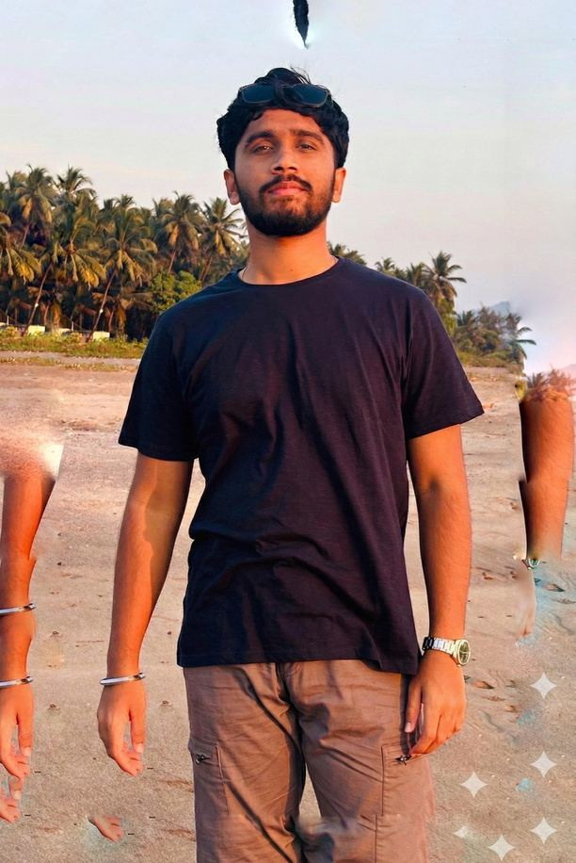


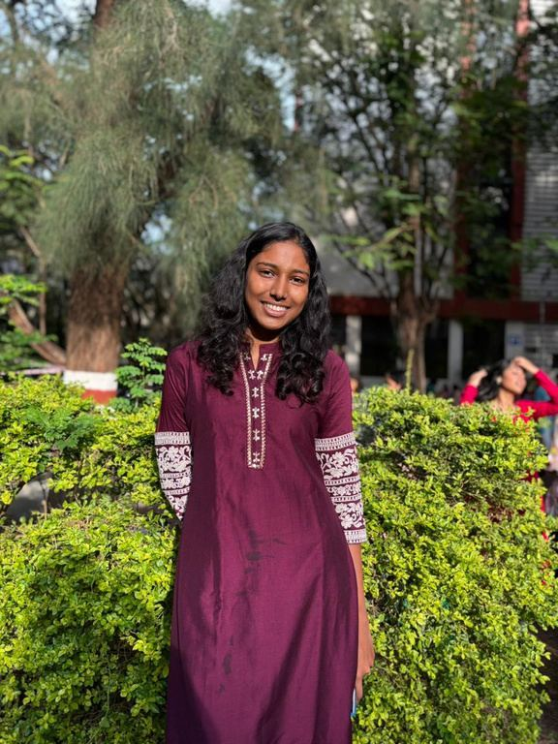
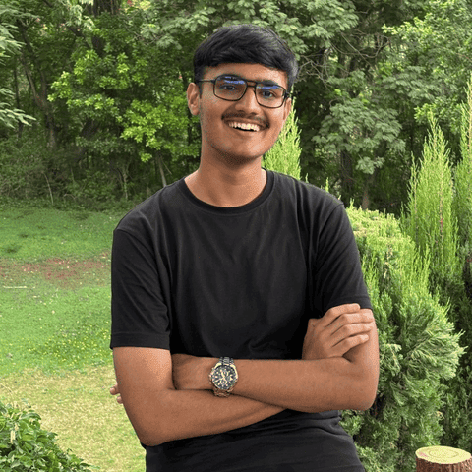
Project Title
KrishiSaarthi
Srujan Satav,Electronics and Telecommunication Engineering
Team Number : 15
Insert your professional photo
Pune Institute of Computer Technology, Pune-411043
Kanishka Salgude,
Information Technology
Sanskar Tiwari,Electronics and Telecommunication Engineering

Slide 3
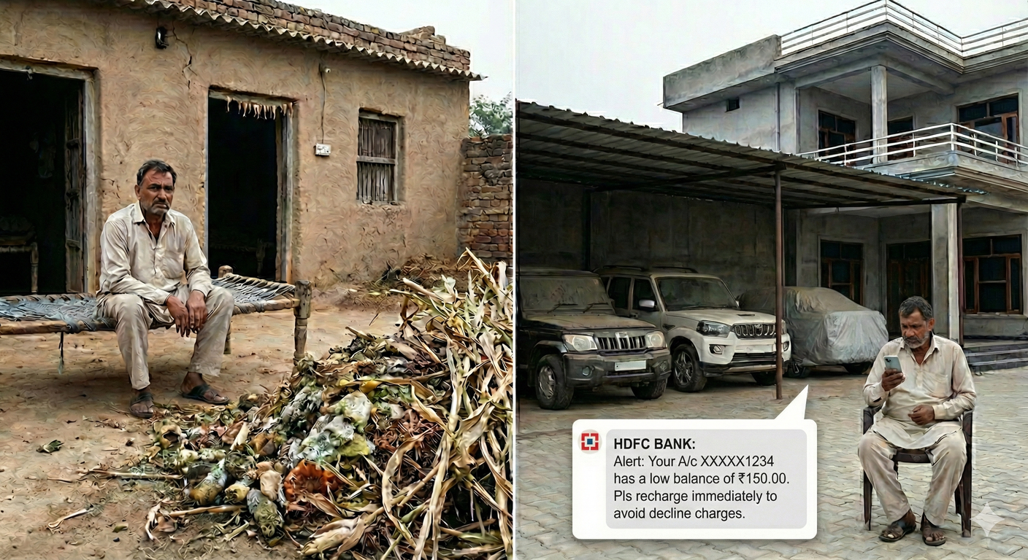
Problem Statement
The Challenge: Indian farmers aren't just struggling - they're systematically losing money they should be making.
  Diagnostic Blindness: Delayed diagnosis = 20% yield lost. ₹50K-₹1.5L gone. 86% small farmers can't afford it.
  The ₹15,000 Crore Bonfire: 23M tonnes burned. ₹25K-₹50K/year torched. Waste = wealth. Nobody told them.
  Capital Annihilation: The "Jewar Effect" - crores of compensation vanishes. Farmers trade land for cash, then burn it on liabilities. Result: Back to poverty in 3 years.
  Sustainability Exploitation: Farmers go green. Corporates profit billions. Farmer gets nothing.
This isn't inefficiency - it's a ₹15,000 crore market begging for disruption.
Sources: Agricultural Census 2015-16 | ICAR Crop Loss Report 2023 | NITI Aayog Land Compensation Study 2022 | Jewar and Purandar Airport compensation case study

Slide 4






Need of Project
Isolated Solutions Don't Fix Systemic Collapse!
Green Credits
Exist on paper only.
The Missing Link:
KrishiSaarthi
No platform connects the person (Finance), the farm (Personalization), and the planet (Waste-to-Value).
Manual verification = 6-18 months. Farmers never get paid.
The Complete Puzzle: Centered on the Farmer
1. Farmer-Centric Treats the person's financial health (debt/income), not just the plant's survival.
2. Future-Proof Transforms temporary land compensation into lifelong family security.
Land-acquired farmers :
lose 68% of compensation in 3 years. No financial literacy. No advisory.
Solve disease. Ignore debt. (60% suicides = financial crisis)
Crop Apps:
3. Direct Reward Ensures the human steward gets paid for sustainability, not the middlemen.

Slide 5
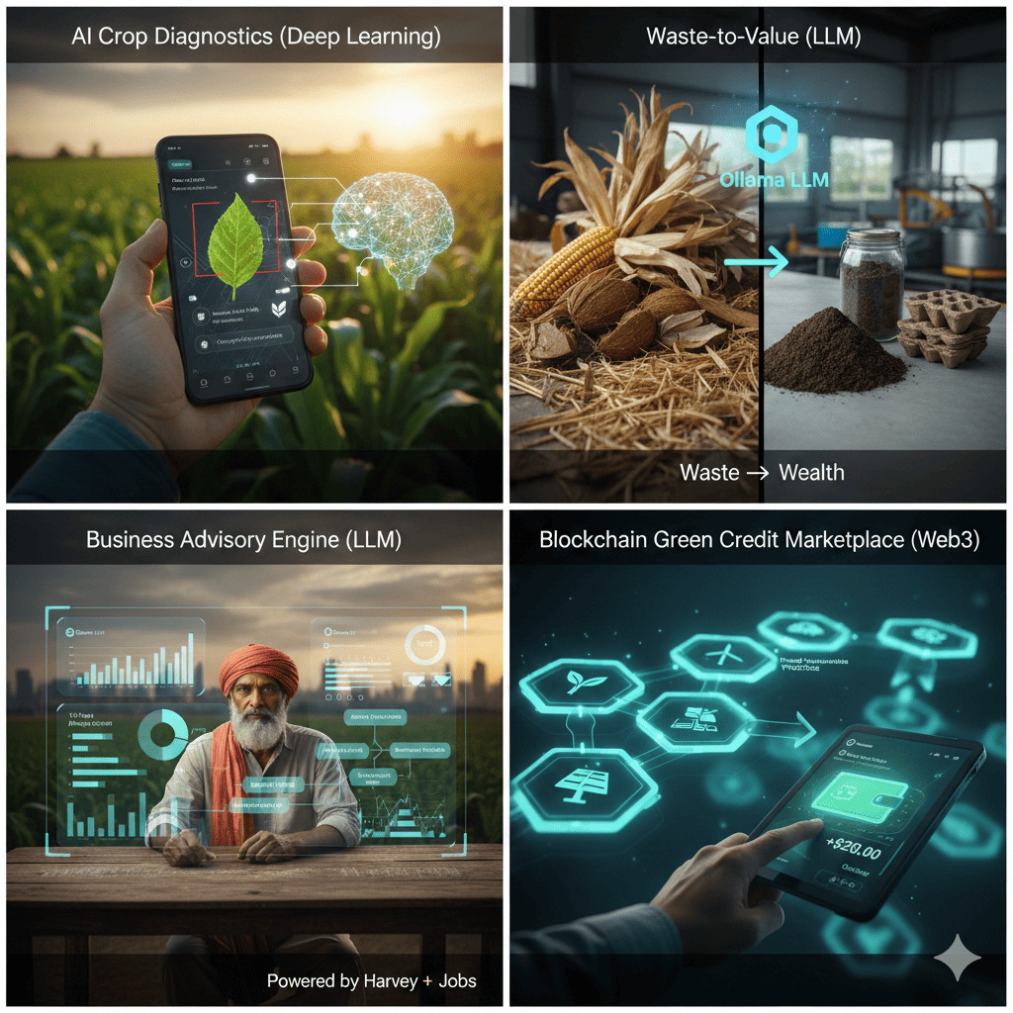
Proposed Solution
Farm to Finance: One Platform. Zero Gaps.
1. AI Crop Diagnostics:
Instant, 96% accurate disease detection and treatment protocols from a single photo.
3. Business Advisory:
4. Green Credit Marketplace:
2. Waste-to-Value:
Converts crop residue (husks, stalks) into sellable bio-fuel and industrial materials.
Strategizes compensation money and land to build high-ROI business models with 10-year income roadmaps.
Validates sustainable practices via blockchain for transparent credit monetization with corporate buyers.
We don't ask "What do you grow?" We answer "How should you invest, protect, and profit?”

Slide 6
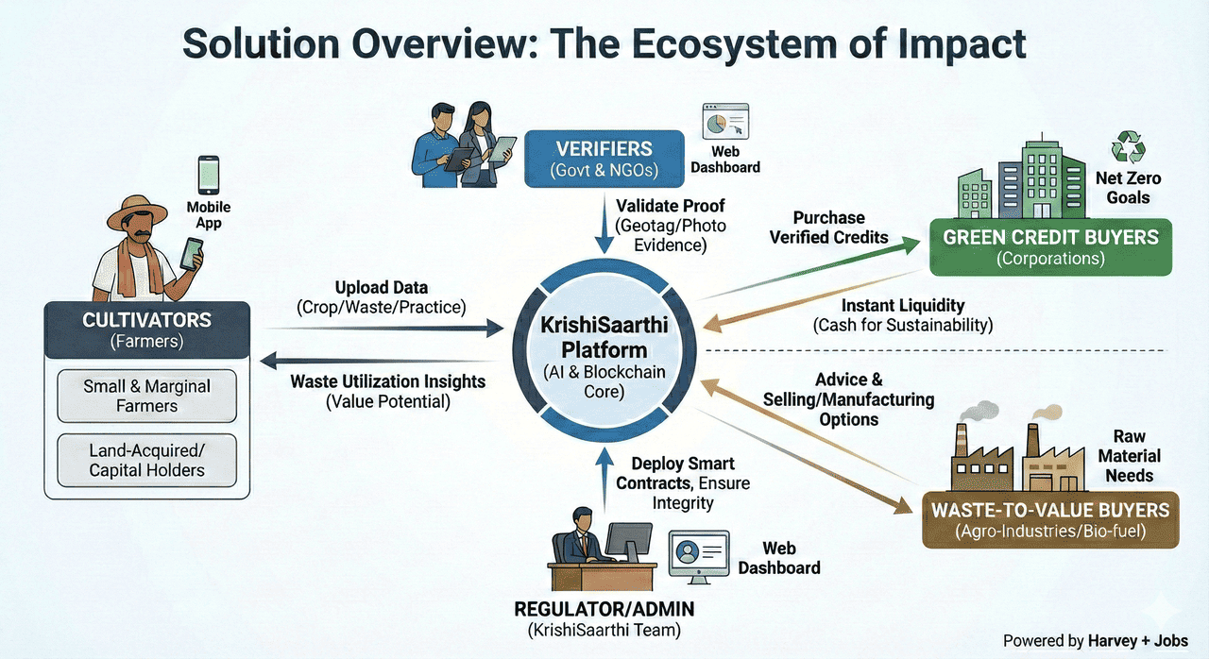
Solution Overview

Slide 7
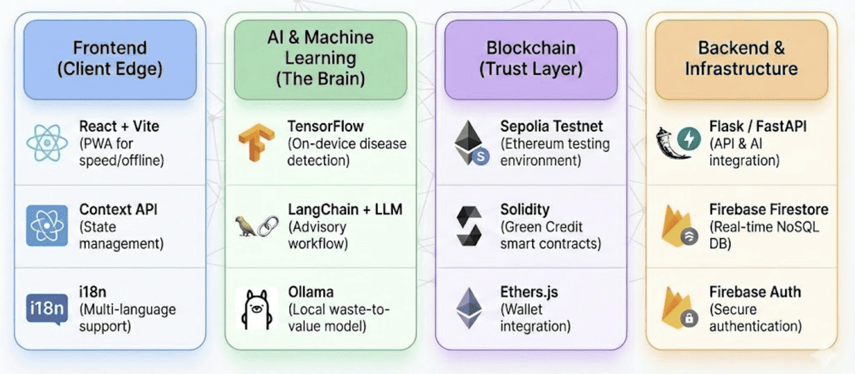
Technology used
5

Slide 8
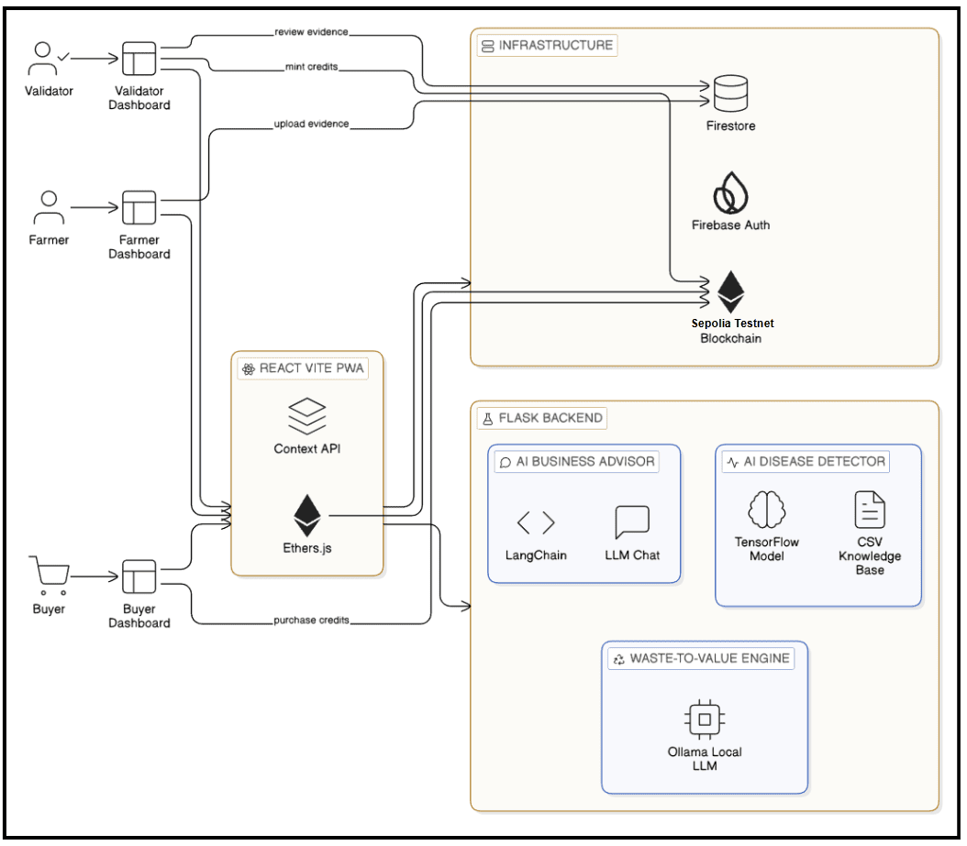
Technical flow diagram -

Slide 9
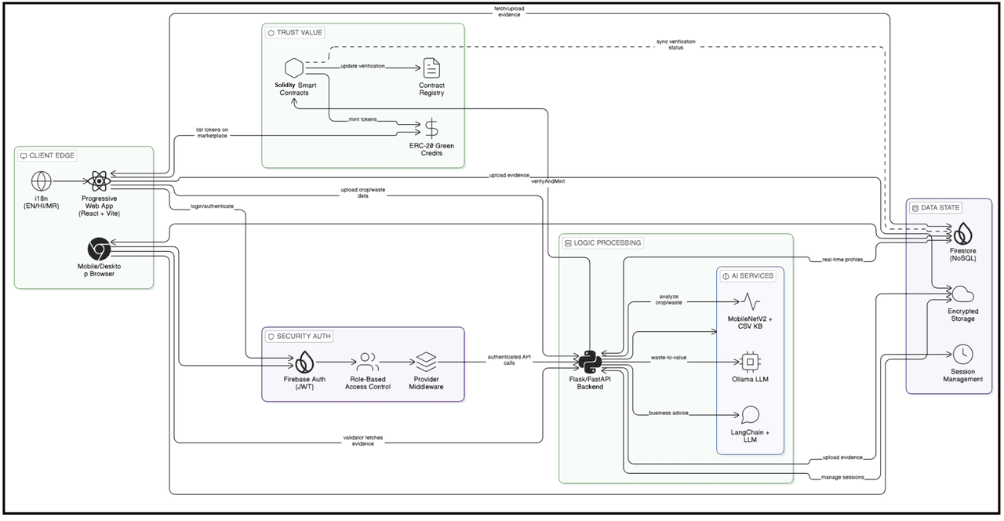
Architecture Blueprint

Slide 10

Screen shots of your project -

Slide 11
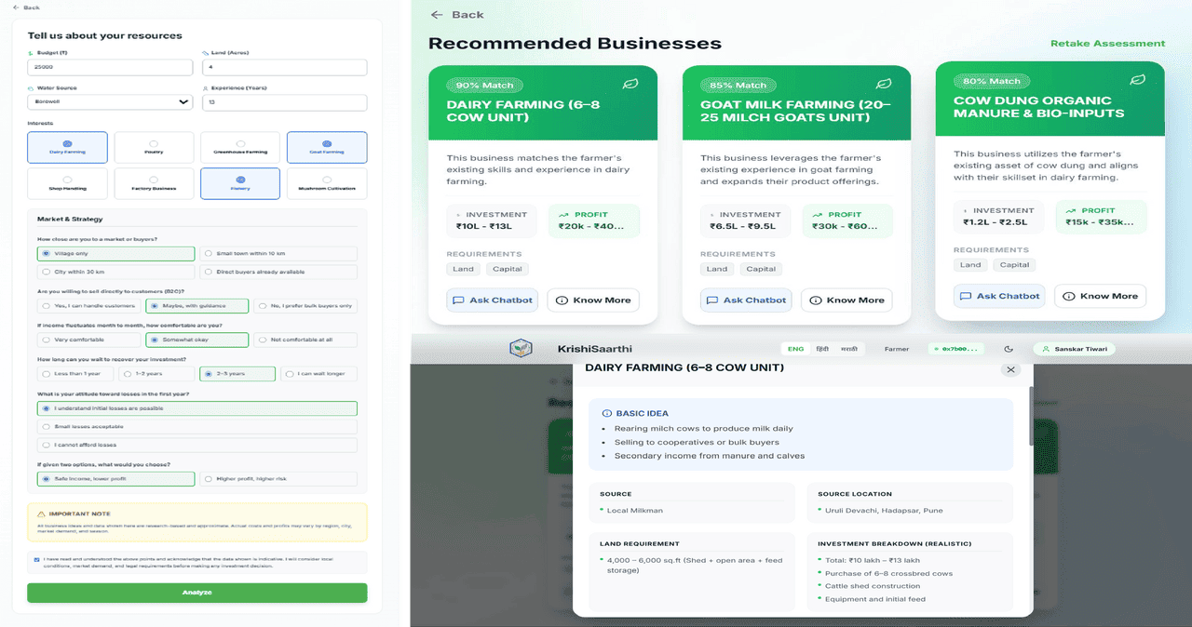
Screen shots of your project -

Slide 12
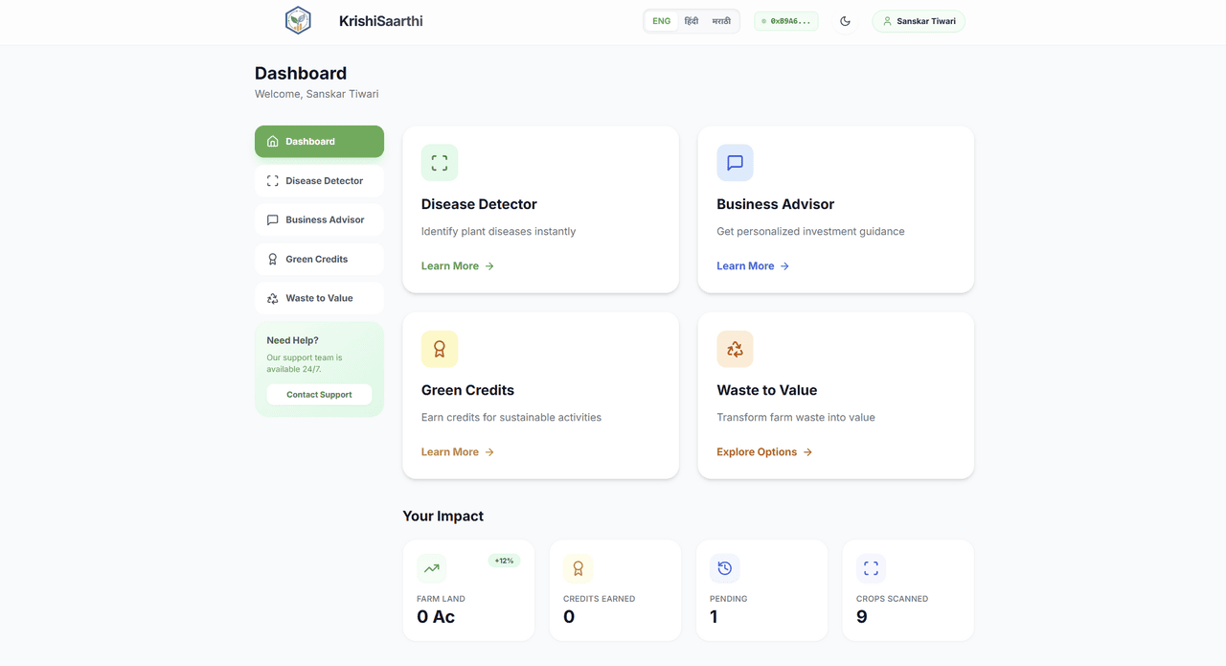
Screen shots of your project -

Slide 13


Novelty and Uniqueness
A Unique Platform that understands the human behind the Farm
Blue Ocean Strategy
Farmer (More Than a Cultivator)
Not competing. Creating a new niche: "Farmer Wealth Management + Sustainability Marketplace"
Only Platform Teaching Wealth Creation:
Win Either Way Treatment or Revenue:
Purandar Airport, Samruddhi Mahamarg = 50,000+ compensated farmers by 2030. Our research: Wealth wasted. Zero advisory. We fill the gap.
Disease detected early? Save it. Too late? Monetize the waste. Farmers burn ₹2 lakh Cr/year. We turn total loss into partial recovery. First dual-model platform.
Sources:
Bharatmala Pariyojana (morth.nic.in), Samruddhi Mahamarg (msrdc.org), Purandar Airport (aai.aero). Field research: Sharad Jagtap (Purandar), Kiran Salgude (Lasalgaon).
No Two Farmers Get the Same Advice:
10+ unique inputs per farmer: Capital, land, skills, market access, risk tolerance. Every farmer gets a different business model. Zero generic templates. True individual intelligence.
IFPRI Study 2019 on crop burning economic loss. PlantVillage Dataset (Mohanty et al., 2016).
Adjacent Players analysis: AgroStar, DeHaat, BharatAgri (crop-generic advisory platforms).

Slide 14
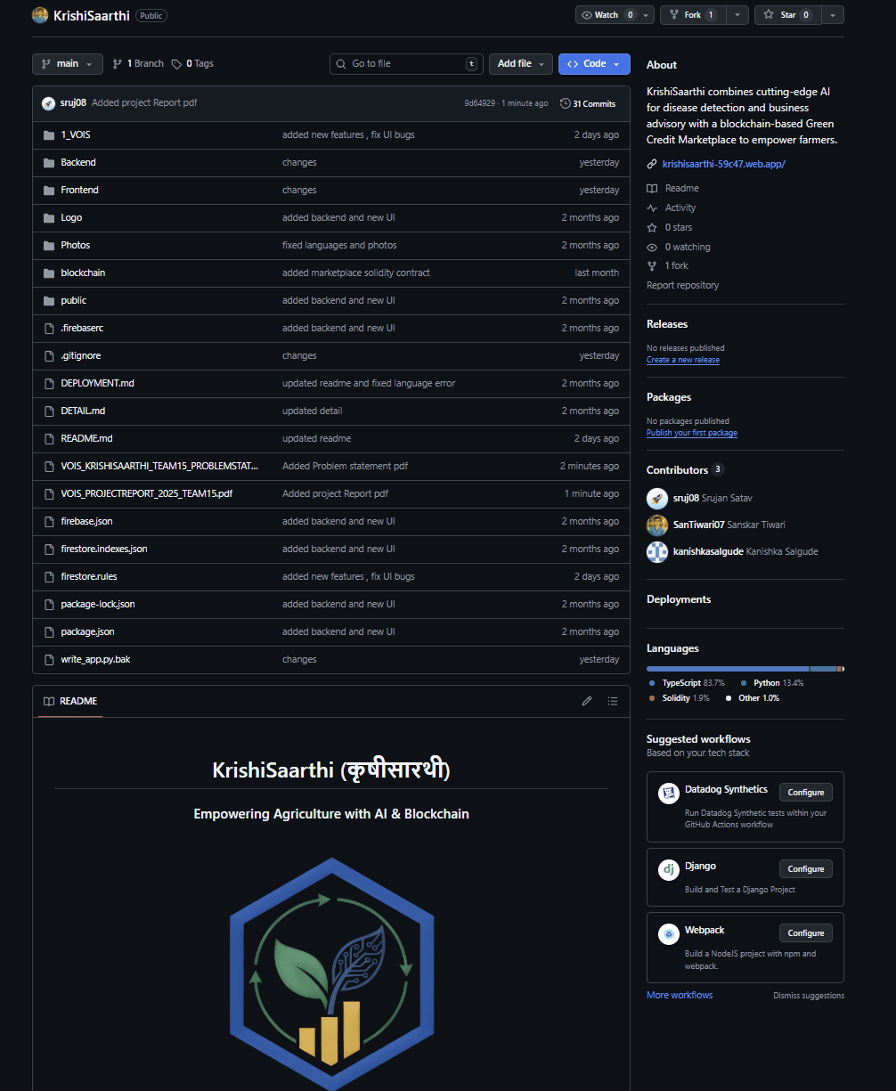

https://github.com/SanTiwari07/KrishiSaarthi
GitHub Link

Slide 15
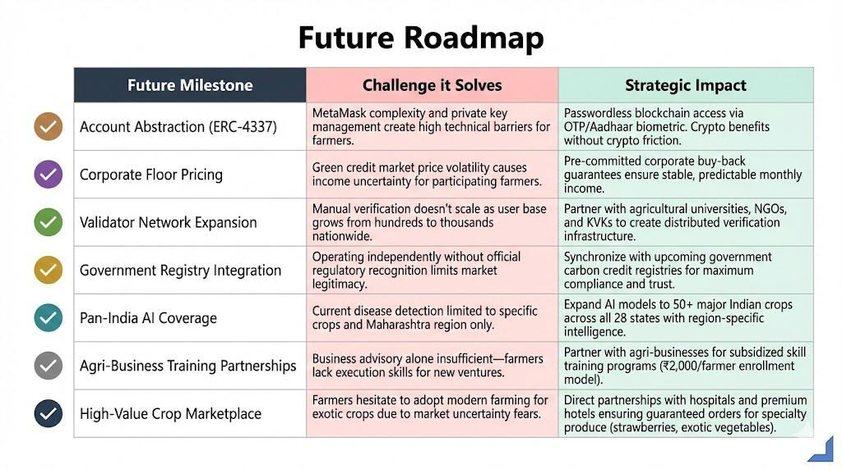
Future Scope

Slide 16
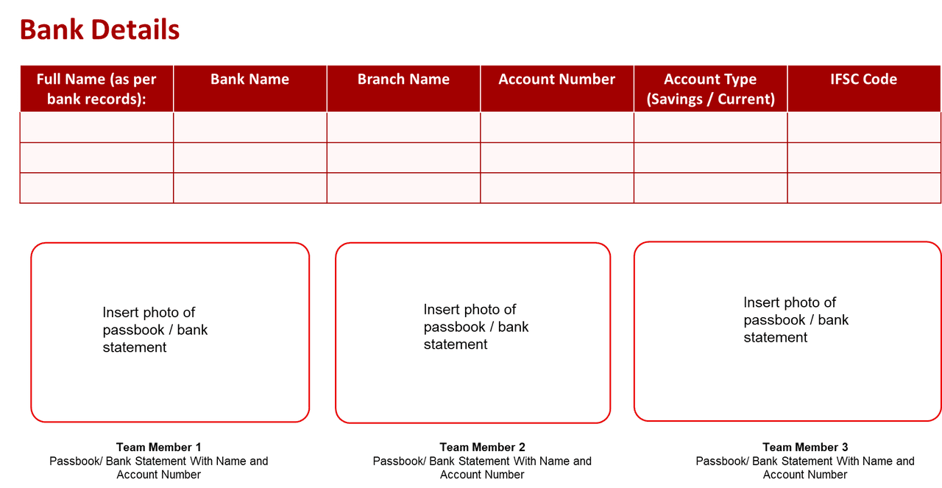
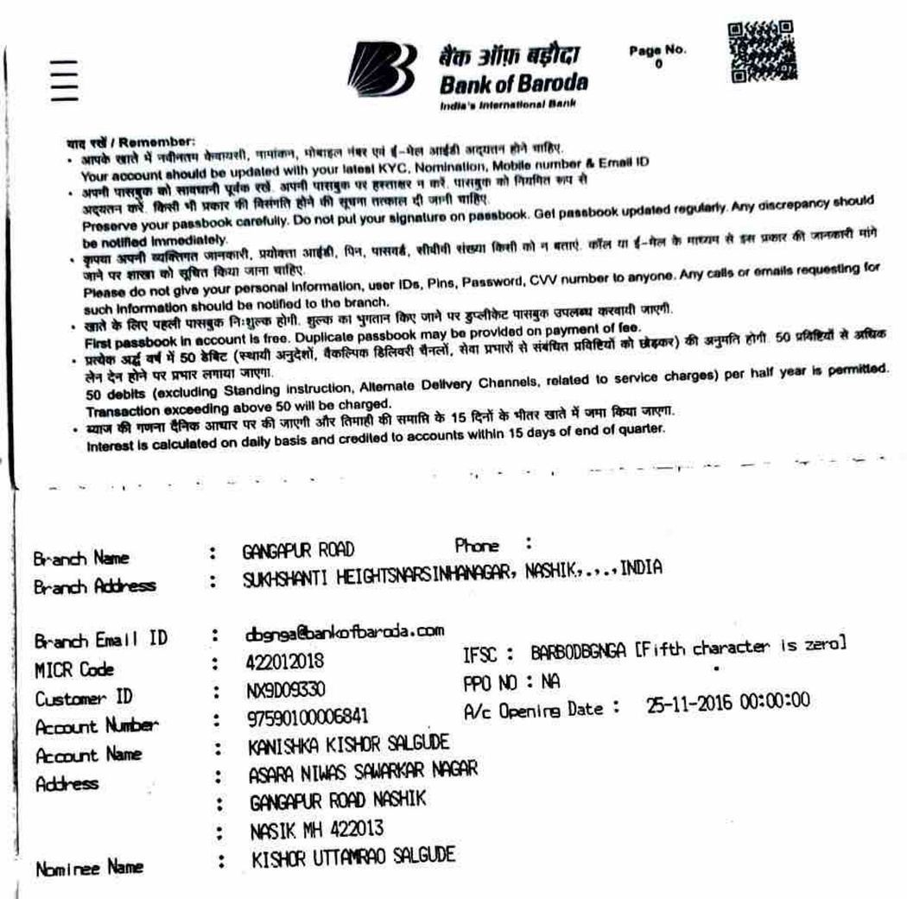
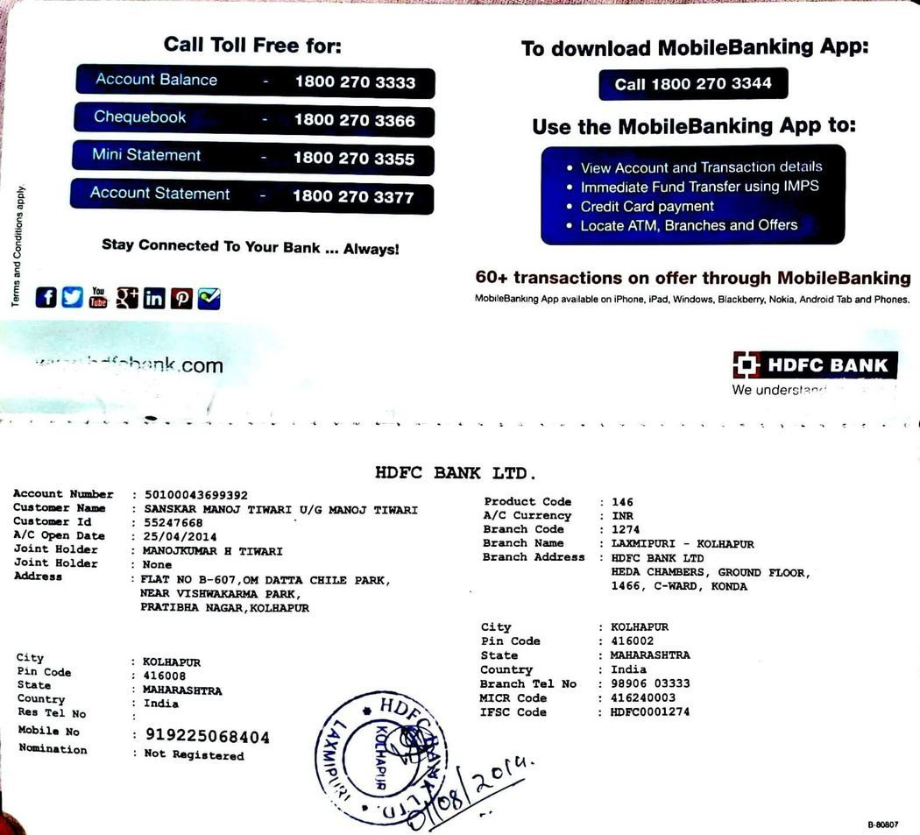
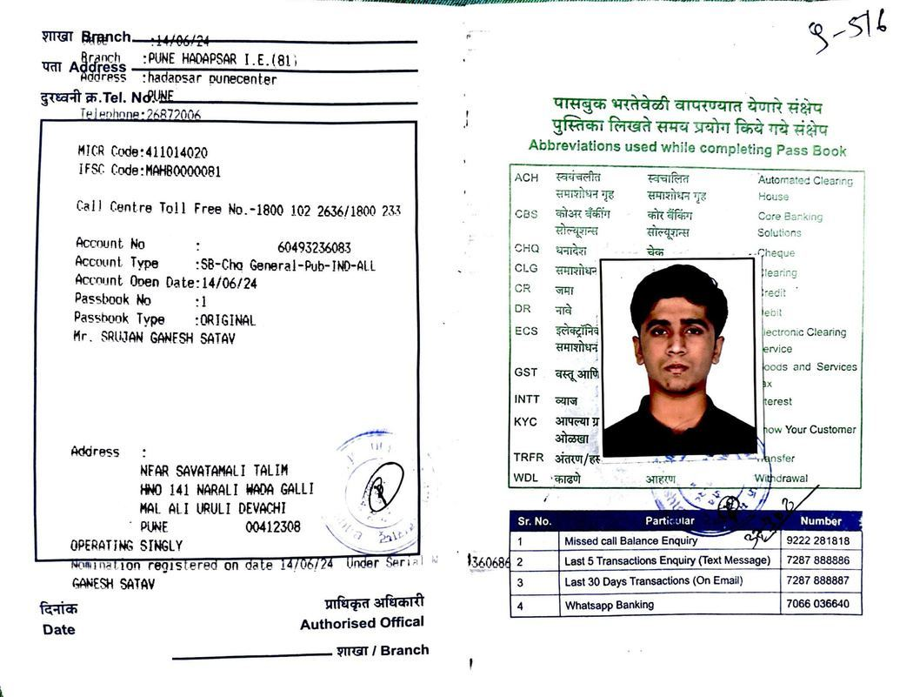
SRUJAN GANESH SATAV
BANK OF MAHARASHTRA
PUNE HADAPSAR I.E.(81)
60493236083
SAVINGS
MAHB0000081
KANISHKA KISHOR SALGUDE
BANK OF BARODA
GANGAPUR ROAD
97590100006841
SAVINGS
BARB0DBGNGA
SANSKAR MANOJ TIWARI
HDFC BANK LTD.
LAXMIPURI-KOLHAPUR
50100043699392
SAVINGS
HDFC0001274
TEAM MEMBER 1 : SRUJAN GANESH SATAV
TEAM MEMBER 2:KANISHKA KISHOR SALGUDE
TEAM MEMBER 3:SANSKAR MANOJ TIWARI

Slide 17
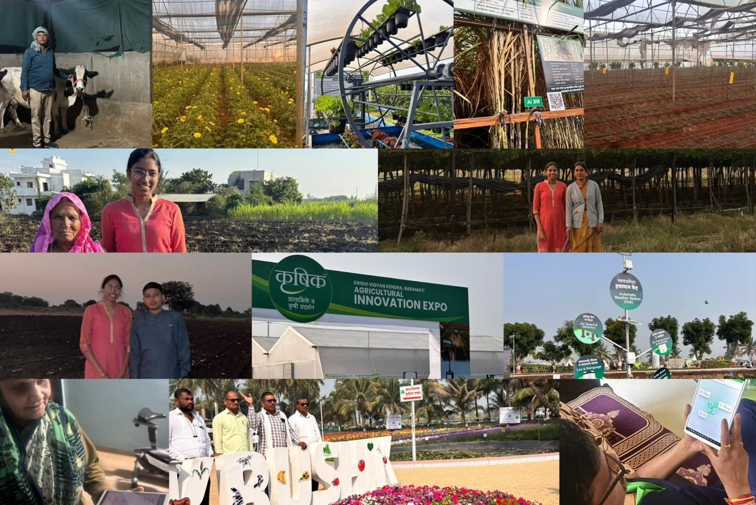
JAI JAWAAN,JAI KISAAN
जय जवान, जय किसान
Thank You

